Slide 1
Movie Recommendation System and AI Agentic Flow In the rapidly evolving digital landscape, recommendation systems have become indispensable tools for navigating the overwhelming volume of available information and products. From e-commerce platforms suggesting purchases to streaming services curating entertainment options, effective recommendation engines enhance user experience, drive engagement, and provide significant business value. This project details the development and analysis of a movie recommendation system designed to address the challenge of providing relevant suggestions. The project focuses on leveraging rich movie metadata to build robust content-based and hybrid recommendation models.
Arup Chakraborty

Slide 2
Presentation Objectives
Goals
We address the problem of delivering relevant, diverse, and controllable movie recommendations.
Use sentiment-analysis for movie recommendation based on user’s text-based search
Present the project’s scope and motivation
Address the challenges of building recommendation systems without explicit user ratings.
Describe the dataset and its relevance
Overview of TMDB 5000 dataset and key features used.
Explain the data preparation and feature engineering
From raw metadata to enriched “soup” features and sentiment scoring.
Detail the modeling approaches
Content-based, hybrid, autoencoder, clustering, and embedding-based methods.
Showcase model performance and observations
Qualitative assessments and impact of feature engineering/tuning.
Highlight future enhancements
Integration of collaborative filtering, user interaction data, and advanced hybrid models.

Slide 3
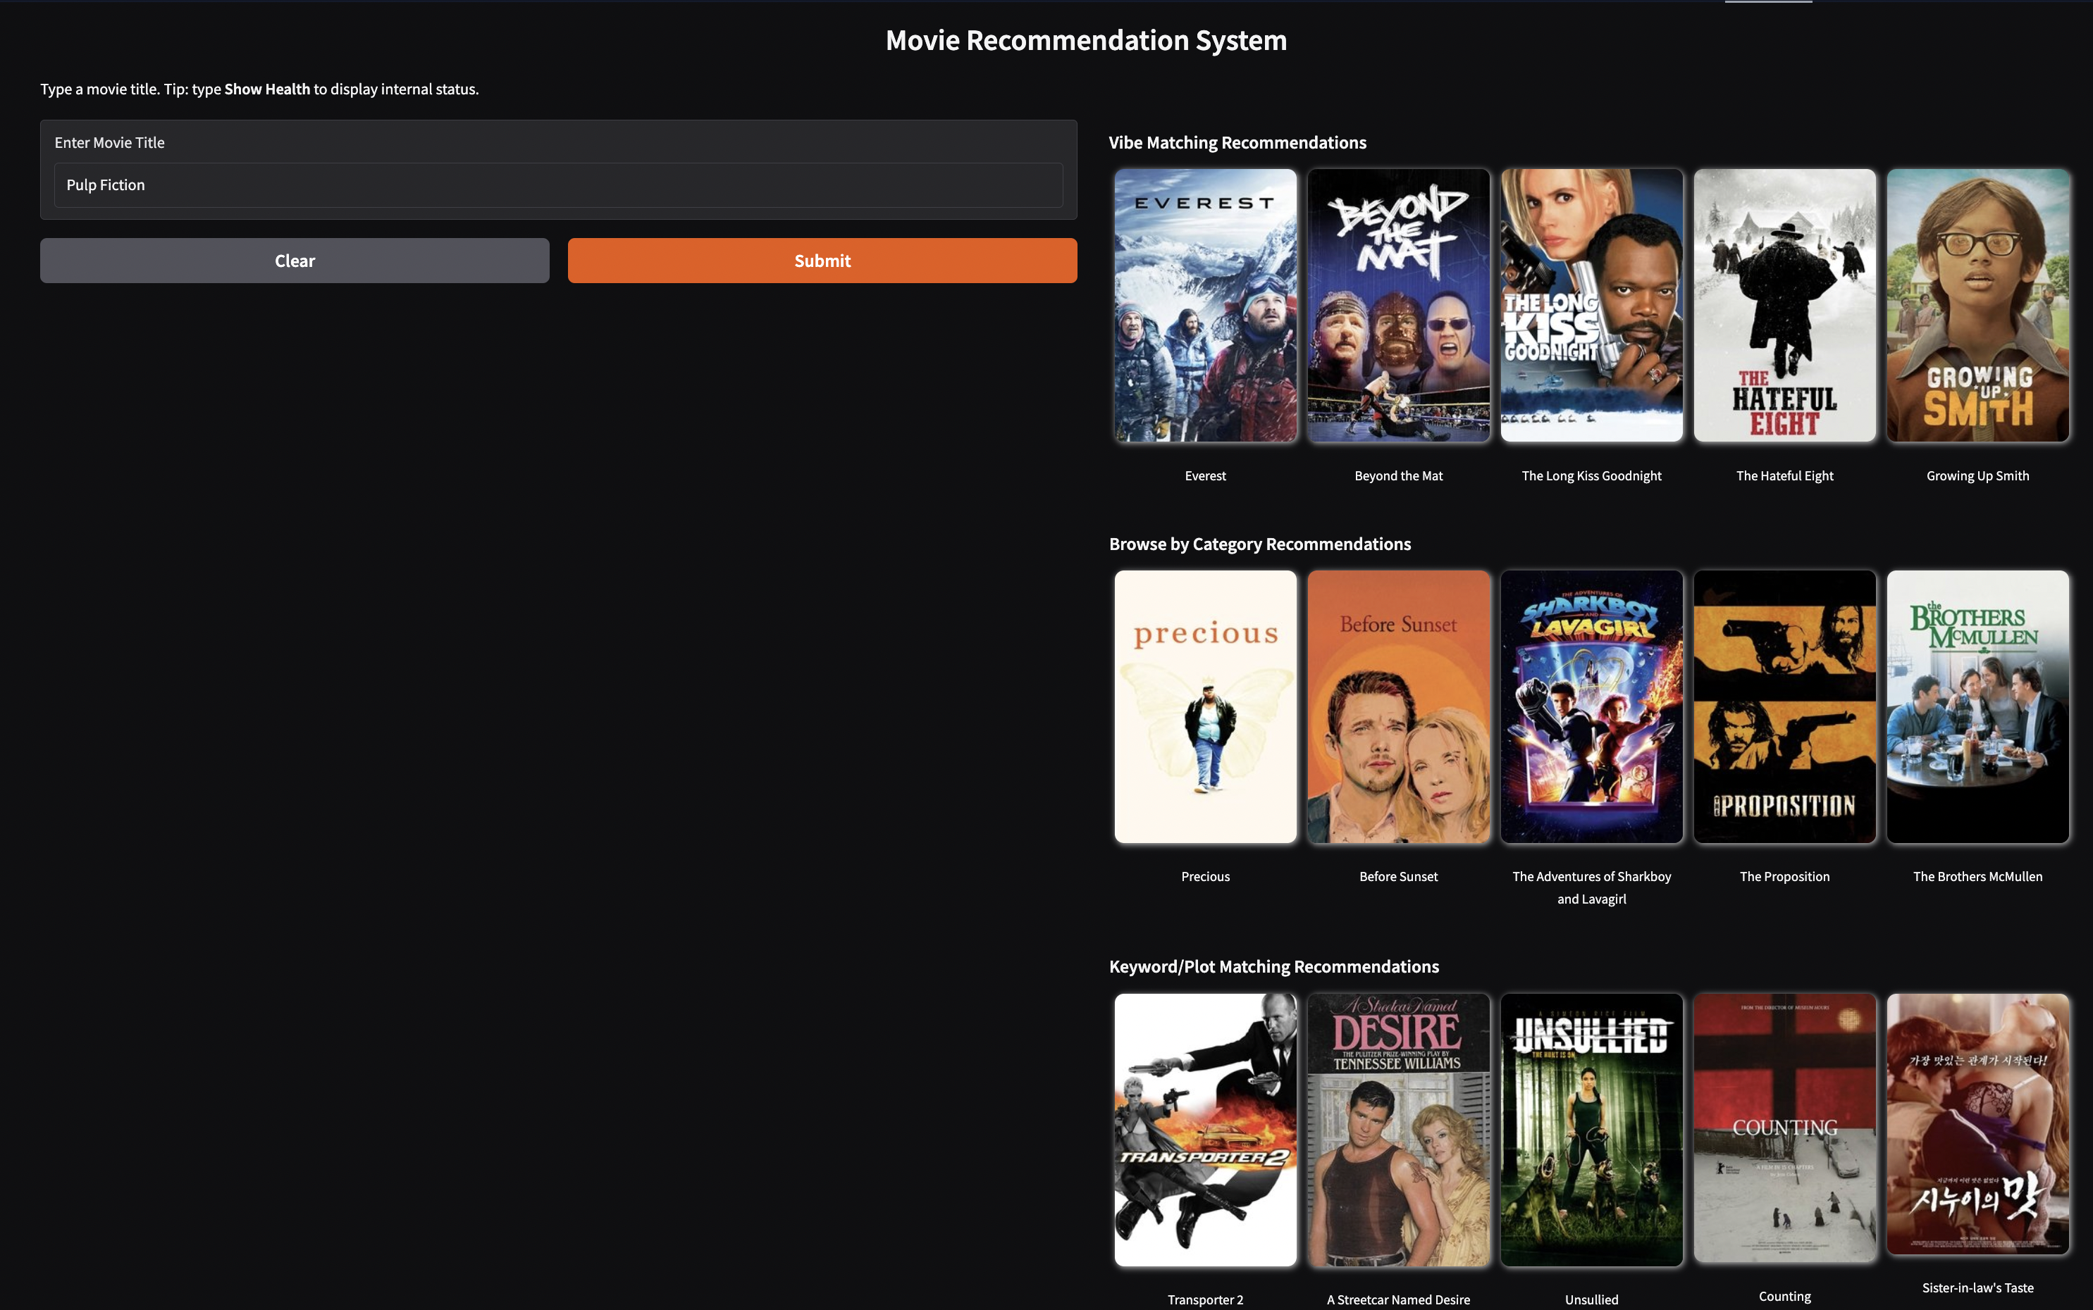
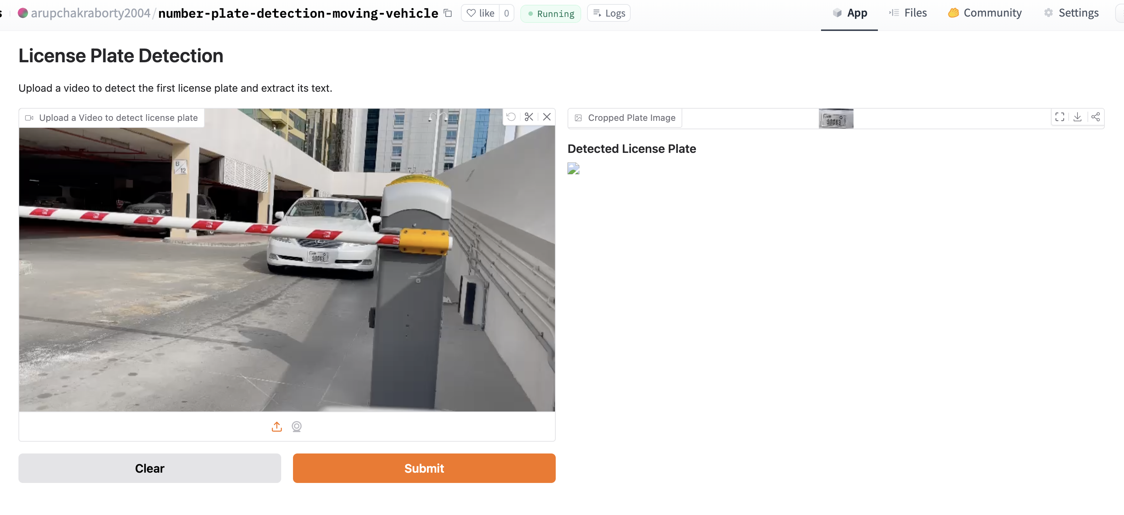
Demo for Movie recommendation System
https://huggingface.co/spaces/arupchakraborty2004/MovieRecommendationsV1

Slide 4
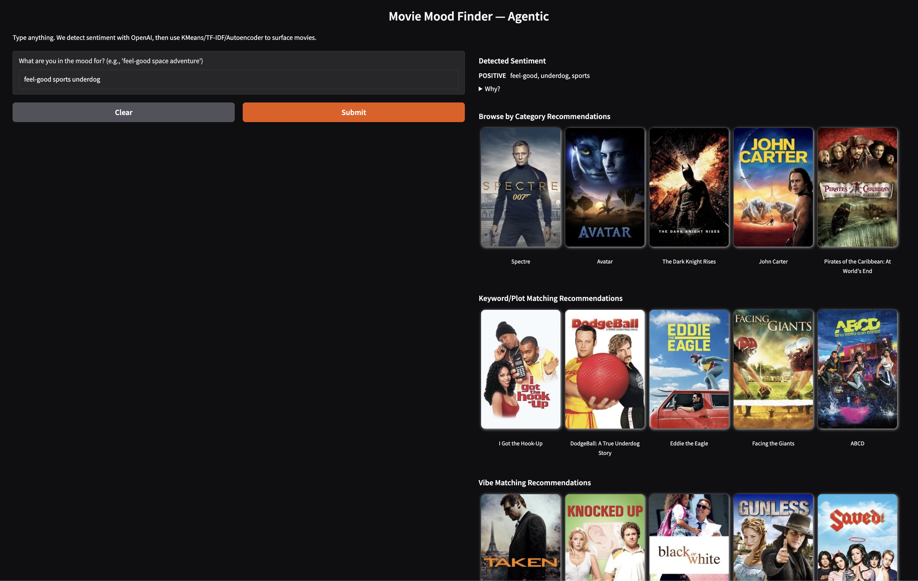
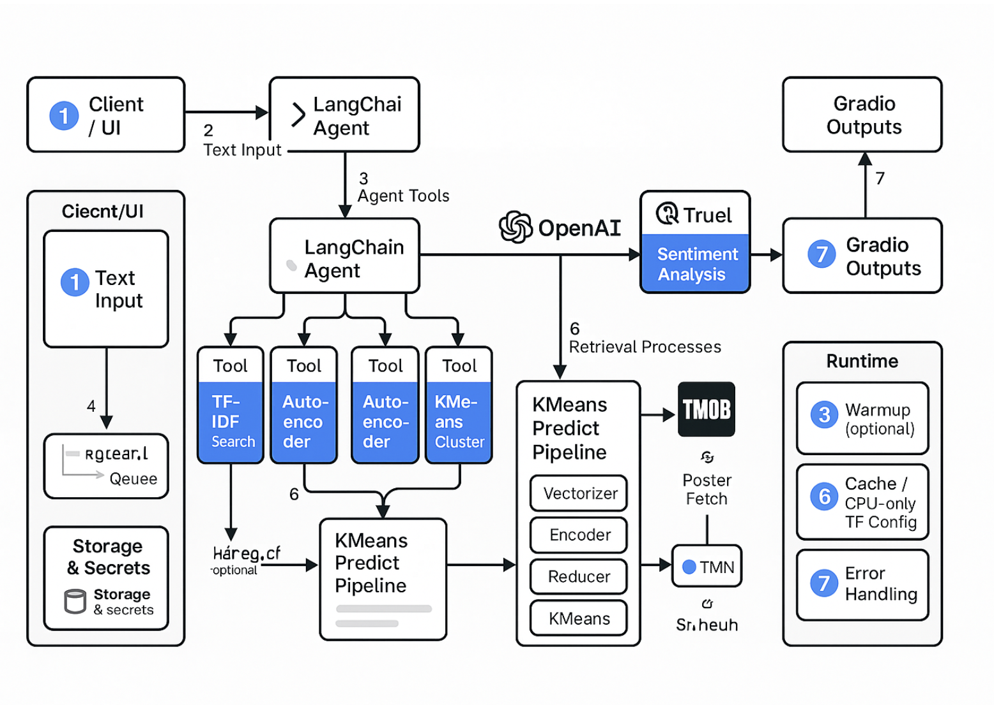
Demo for movie recommendation with agentic flow and user’s sentiment
https://huggingface.co/spaces/arupchakraborty2004/MovieRecommendationSystemV2

Slide 5
Abstract/Overview
Benefits
Generates relevant recommendations without user history.
Incorporates sentiment for emotionally aligned suggestions.
Provides transparency through natural language explanations.
Modular design supports scalability and future feature expansion.
Project Approach
Use TMDB 5000 dataset with metadata-driven content-based and hybrid methods.
Apply TF–IDF, autoencoders, Sentence-BERT, clustering, and kNN.
Integrate sentiment-aware re-ranking and AI agentic flow for explainability.
Deliver robust item-to-item recommendations and define next steps toward full personalization.
Focus Issues
Lack of explicit user ratings limits personalized recommendations.
Existing systems often ignore emotional tone in suggestions.
Need for explainable, scalable, and adaptable recommendation workflows.

Slide 6
Overview of Dataset
Source: TMDB 5000 Movie Dataset (movies + credits CSVs)
Total Movies: 4,800+ entries after merging datasets
Key Features:
Metadata: title, genres, keywords, release year, production details
Cast & Crew: director, actors, production companies
Text Fields: movie overviews for content and sentiment analysis
Interaction Signals: vote count, average rating (non-personalized)
Derived Features:
“Soup” & “Enhanced Soup” for TF–IDF vectorization
Sentiment scores from VADER
Autoencoder-generated latent vectors
K-means cluster labels for group-based recommendations
Why This Dataset?
Rich metadata supports cold-start recommendations
No explicit user ratings → ideal for testing content-based and hybrid methods

Slide 7
Methods – Data Preparation and Feature Engineering
Data Cleaning:
Parsed JSON fields (genres, keywords, cast, crew, production details).
Handled missing values in text fields (e.g., overview) by filling with empty strings.
Standardized text format for consistent processing.
Feature Creation:
Soup: Combined genres, keywords, overview, cast, and director into a single text feature.
Enhanced Soup: Added production companies, countries, and languages.
Extracted director field from crew data.
Generated sentiment scores from overviews using VADER.
Created latent vectors from autoencoder.
Assigned cluster labels via K-means.
Text Preprocessing:
Removed stop words, applied lemmatization for semantic accuracy.
Used TF–IDF for vectorization of text-based features.
Purpose:
Prepare clean, semantically rich features to support content-based, hybrid, and sentiment-aware recommendation models.
Notes:
Arup starts

Slide 8
Data Modeling
Techniques Applied:
TF–IDF + Cosine Similarity – Baseline content similarity.
Autoencoder – Learned compressed latent features for alternative similarity space.
k-Nearest Neighbors (kNN) – Direct retrieval of k most similar movies.
K-means Clustering – Grouped movies into semantic clusters for cluster-based recommendations.
Sentence-BERT – Captured deeper semantic meaning in movie descriptions.
Hybrid Model (Content + Sentiment) – Combined topical and emotional similarity.
Feature Engineering:
Created “Soup” and “Enhanced Soup” features from metadata.
Applied lemmatization for better semantic consistency.
Integrated sentiment scores into ranking.
Goal:
Build modular, explainable models for metadata-driven recommendations in the absence of explicit user ratings.

Slide 9
Methods - Training Model and Evaluation
Training Approaches:
Autoencoder:
Input & target: TF–IDF matrix
Optimizer: Adam | Loss: Mean Squared Error (MSE)
Tuned encoding dimensions (64, 128, 256), epochs (20–50), batch sizes (128–256)
Early stopping used in some experiments
K-means Clustering:
Applied to autoencoder latent space
Used Elbow Method for optimal n_clusters selection
Sentence-BERT:
Used pre-trained embeddings without fine-tuning
kNN:
Retrieved k most similar movies from TF–IDF space
Evaluation Methods:
No explicit ratings → relied on qualitative assessment of recommendations
Compared model outputs for sample movies and queries
Observed impact of:
Hyperparameter tuning
Feature engineering refinements
Sentiment integration
Key Insight:
Feature quality and preprocessing choices significantly influence recommendation relevance and diversity.

Slide 10
Results/Discussion - Model Performance Evaluation
Overall Findings:
Generated plausible, relevant recommendations without user ratings.
Feature engineering (lemmatization, metadata enrichment) noticeably improved quality.
Sentiment integration enabled emotionally aligned suggestions.
Model Highlights:
TF–IDF (Baseline): Accurate for content similarity; bi-grams improved context capture.
Autoencoder: Revealed alternative similarity patterns; latent space tuning impacted results.
kNN: Flexible control over similarity strictness via k.
K-means: Cluster-based recommendations captured thematic groupings.
Sentence-BERT: Detected nuanced semantic relationships missed by TF–IDF.
Hybrid Model: Balanced topical and emotional relevance through adjustable weights.
Performance Evaluation:
Qualitative review due to lack of rating-based ground truth.
Sensitivity noted—small changes in preprocessing or parameters led to distinct recommendation shifts.
Key Takeaway:
Metadata-driven + sentiment-aware methods can deliver robust recommendations in cold-start scenarios.
AI agentic flow was incorporated to understand user sentiment to recommend movies

Slide 11
Observations and Future enhancements
Key Observations:
Rich metadata can effectively drive recommendations in absence of user ratings.
Sentiment adds a valuable emotional alignment dimension.
Model outputs are highly sensitive to preprocessing and hyperparameters.
Different models capture different similarity perspectives (e.g., topical vs. semantic).
Future Enhancements:
Integrate user interaction data for personalization (ratings, clicks, watch history).
Implement collaborative filtering (SVD, ALS, neighborhood models).
Develop advanced hybrid systems combining content & collaborative signals.
Swap TF–IDF with sentence embeddings (SBERT) and measure semantic drift.
Incorporate sequence-aware models for session-based recommendations.
Expand sentiment to aspect-level (acting, cinematography) for fine control.
Conduct online A/B testing to validate offline gains.
Provide & collect user feedback loops to refine recommendations.
Notes:
The accuracy for model predictions depends on quite a few factors:
Data Quality and Quantity
More Data: Generally, more data leads to better model performance.
Data Augmentation: Techniques like rotation, scaling, cropping, and flipping can help the model generalize better by providing a more diverse set of training examples.
Balanced Dataset: We need to prevent the model from becoming biased toward more frequent classes.
Model Architecture
Depth of the Network: Adding more layers can help the model learn more complex patterns, but too many layers might lead to overfitting.
Hyperparameter Tuning: Optimizing hyperparameters, including the number of filters, kernel size, and activation functions, can significantly impact model performance.
Regularization Techniques
Dropout: Randomly dropping units from the neural network during training can prevent overfitting.
Weight Regularization: Adding L1 or L2 regularization to the model weights can also help prevent overfitting by penalizing large weights.

Slide 12
References
Burke, R. (2002). Hybrid recommender systems: Survey and experiments. User Modeling and User-Adapted Interaction, 12(4), 331–370. https://doi.org/10.1023/A:1021240730564
Hinton, G. E., & Salakhutdinov, R. R. (2006). Reducing the dimensionality of data with neural networks. Science, 313(5786), 504–507. https://doi.org/10.1126/science.1127647
Hutto, C. J., & Gilbert, E. (2014). VADER: A parsimonious rule-based model for sentiment analysis of social media text. Proceedings of the Eighth International AAAI Conference on Weblogs and Social Media (ICWSM-14), 216–225.
Kaggle. (2019). The movies dataset. https://www.kaggle.com/rounakbanik/the-movies-dataset
Pedregosa, F., Varoquaux, G., Gramfort, A., Michel, V., Thirion, B., Grisel, O., … Duchesnay, É. (2011). Scikit-learn: Machine learning in Python. Journal of Machine Learning Research, 12, 2825–2830.
TensorFlow Team. (2015–). TensorFlow: Large-scale machine learning on heterogeneous systems. https://www.tensorflow.org/
LangChain. (2023–). LangChain documentation. https://python.langchain.com/

Slide 13
Thank you!
Notes:
On behalf of Team 11s, thank you for your time watching my presentation.

